Slide 1
Bayesian Integration
(MCMC II)
Fish 558; Day 4: 10h30-12h00

Slide 2
Why Diagnostic Statistics?
There is no guarantee, no matter how long you run the MCMC algorithm for, that it will converge to the posterior distribution.
Diagnostic statistics identify problems with convergence, but cannot “prove” that convergence has occurred.
  The same is true of methods for checking whether convergence of a nonlinear minimizer has occurred.

Slide 3
Overall Scheme
1) Run a pilot chain
Inspect output and modify parameters
2) Run a new chain
Inspect output and modify parameters
3) Run another new chain
Assess convergence
4) Extend the chain
Assess convergence, predict required length
5) Extend the chain again
Assess convergence and summarize results

Slide 4
Three Types of Convergence
1) Slow* - Appears converged
2) Too slow* - Not yet converged, but on the right track
3) Really too slow* - Not yet converged, and will not converge in our lifetime
*From: Debate moderated by Kass, 1998

Slide 5
The Example Problem
The examples from this lecture are based on the fit of an age-structured model.
We want to compute posteriors for:
  the model parameters; and
  the ratio of the biomass in the last year to that in the first year.
Results for two MCMC runs (10,000 with every 10th point saved; 10,000,000 with every 1,000th point saved) are available.

Slide 6
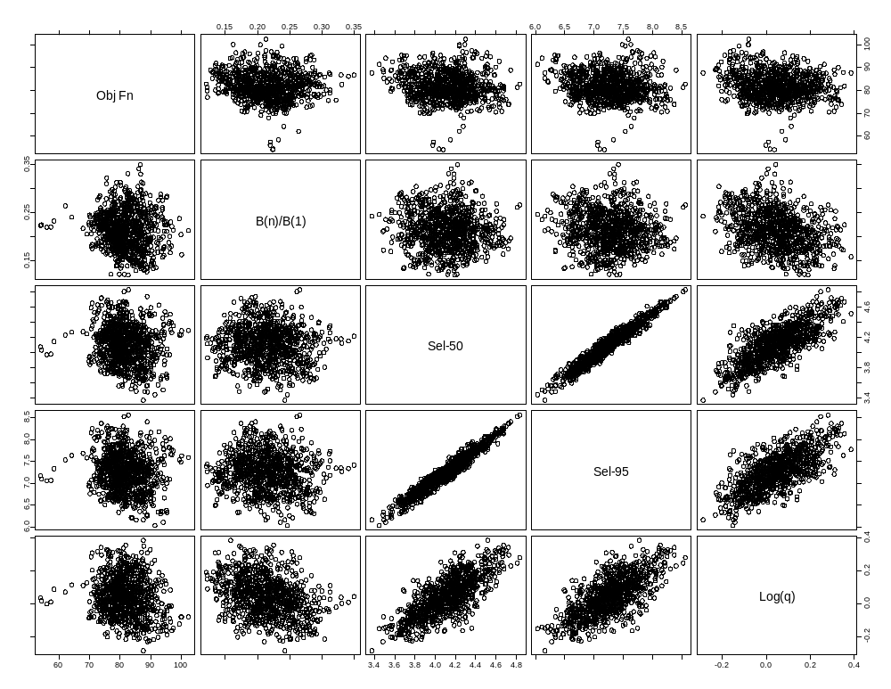
Posterior Correlations
(N=10,000)

Slide 7
Categorizing Convergence Diagnostics-I
There is no “magic bullet” when it comes to diagnostics. All diagnostics will fail to detect failure to achieve convergence sometimes.
Diagnostics:
  monitoring (during a run).
  evaluation (after a run).

Slide 8
Categorizing Convergence Diagnostics-II
Quantitative or graphical.
Requires single or multiple chains.
Based on single variables or the joint posterior.
Applicability (general or Gibbs sampler only).
Ease of use (generic or problem-specific).

Slide 9
MCMC diagnostics
(what to keep track of during a run)
The fraction of jumps that are accepted (it should be possible to ensure that the desired fraction is achieved automatically).
The fraction of jumps that result in parameter values that are “out of range”.

Slide 10
MCMC diagnostics
(selecting “thinning” and “burn-in” periods).
Ideally, the selected parameter vectors should be random samples from the posterior. However, some correlation between “adjacent” samples will arise due to the Markov nature of the algorithm. Increasing N should reduce autocorrelation.

Slide 11
Visual Methods
(The trace-I)
The trace is no more than a plot of various outputs (derived quantities as well as parameters) against cycle number.
Look for :
  trends; and
  evidence for strong auto-correlation.

Slide 12
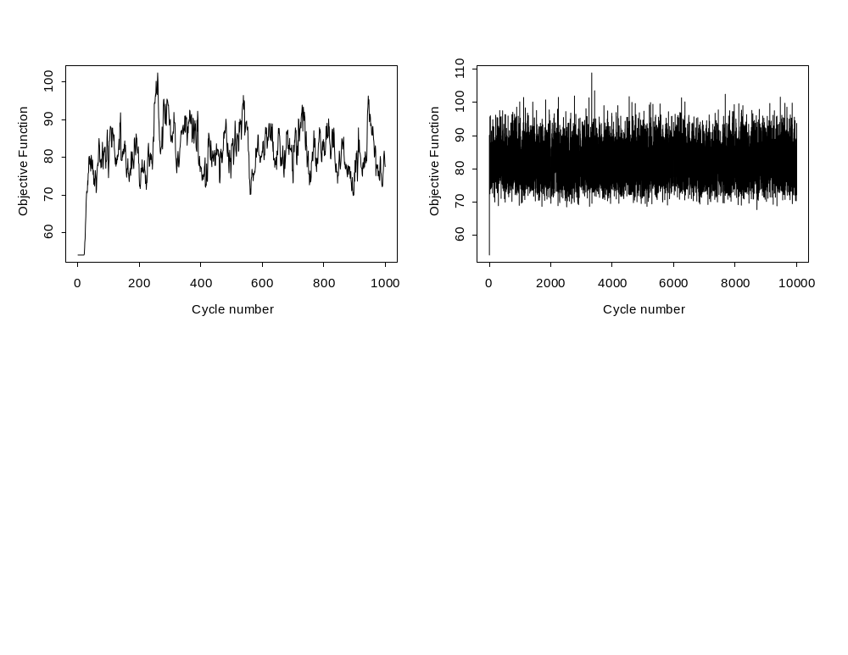
Visual Methods
(The trace-II)
Correlation too high
(more thinning needed)?
Need for a burn-in (the “pigtail”)

Slide 13
Visual Methods
(The trace-III)
The objective function is always
larger than lowest value – why?
Need for a burn-in

Slide 14
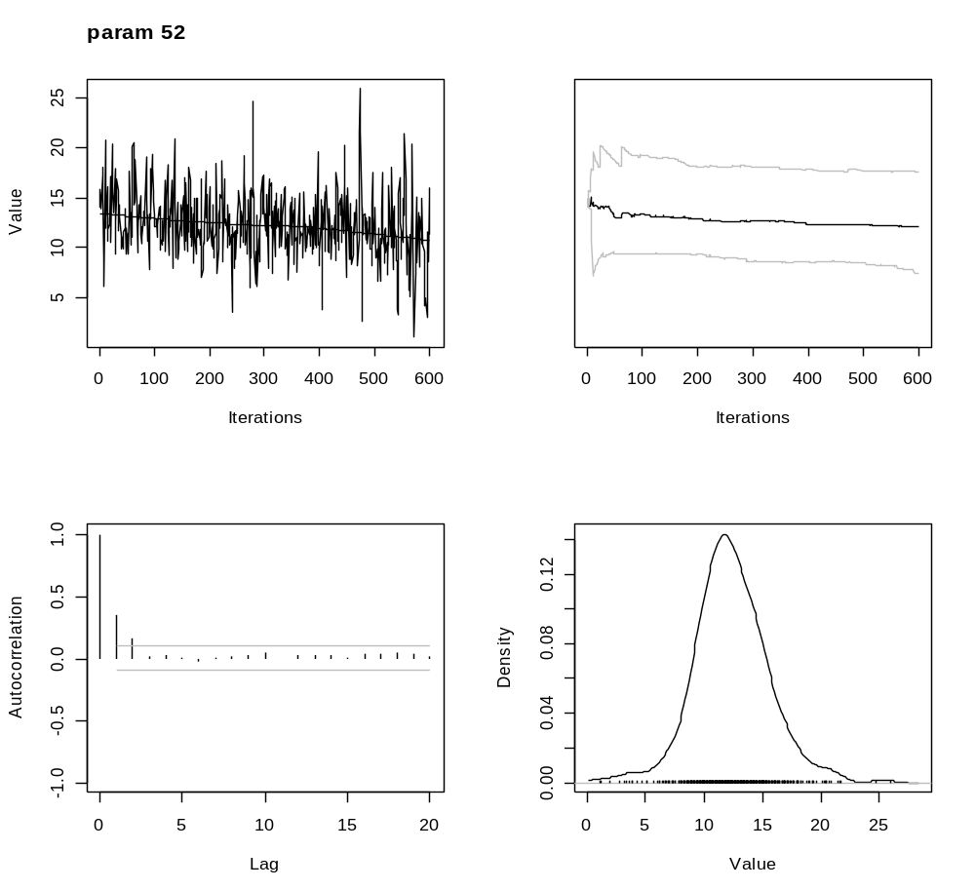
Visual Methods
(The trace-IV)
Trend – not good

Slide 15
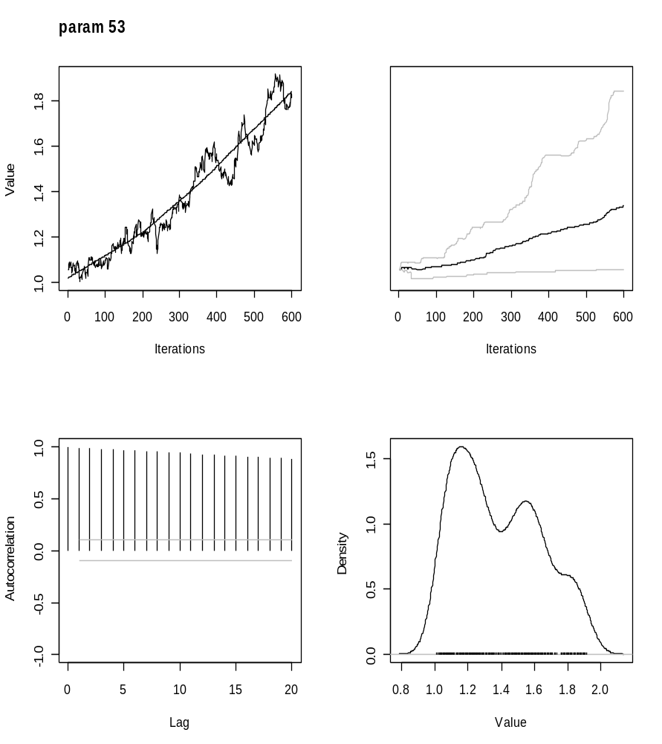
Visual Methods
(The trace-V)
Catastrophic:
probably terminal!

Slide 16
Visual Methods
(The trace-VI)
The trace is not easy to interpret if there are very many points.
The trace can be more interpretable if it is summarized by:
  the cumulative posterior median, and upper and lower x% credibility intervals; and
  moving averages.

Slide 17
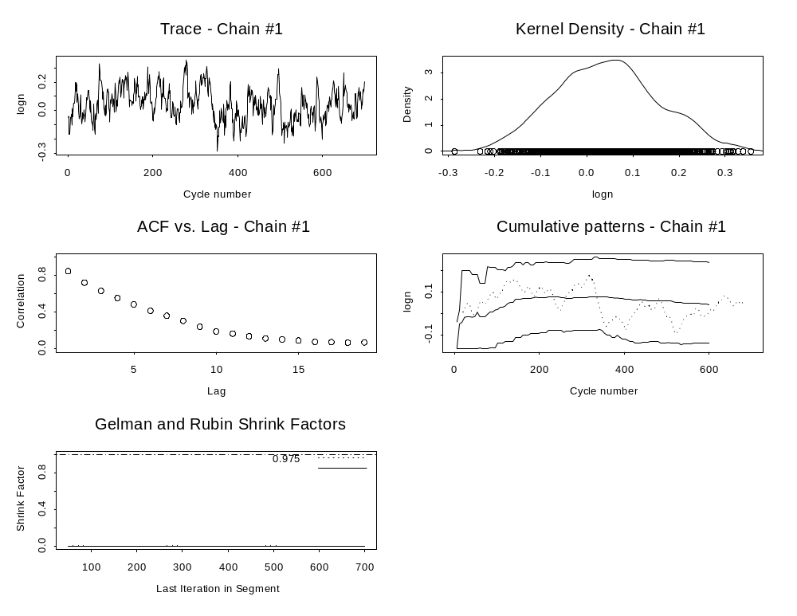
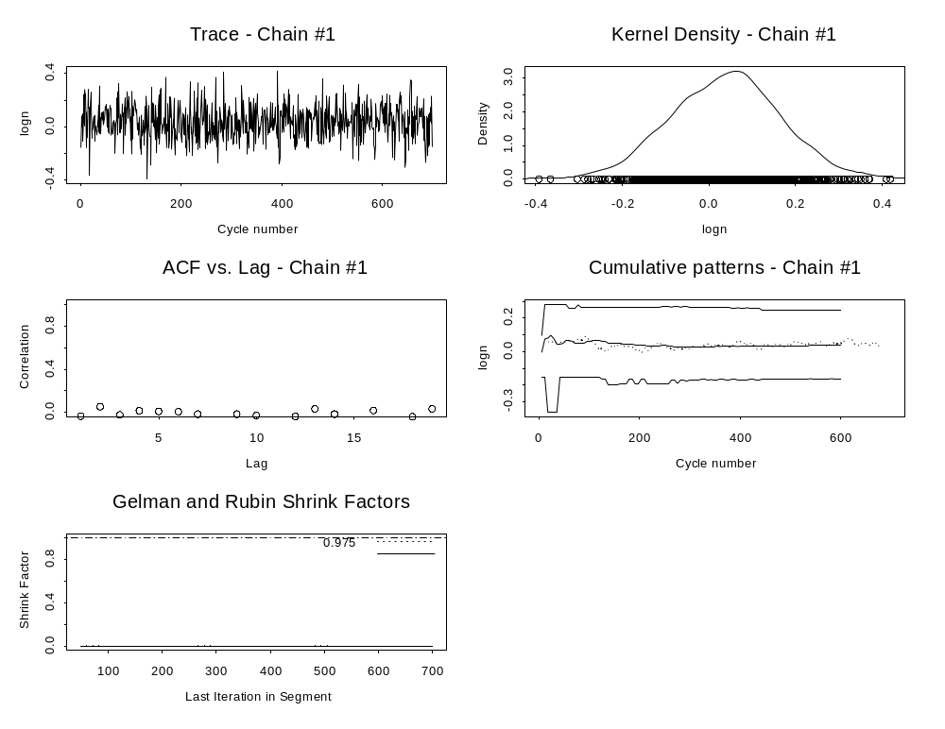
Visual Methods
(The trace-VII)
N=10,000,000
N=10,000

Slide 18

Visual Methods
(The posterior)
Do not assume the chain to have converged just because the posteriors “look smooth” .
This is the posterior for log(q) from the N=10,000 run.

Slide 19
Numerical Statistics I Use
Autocorrelation lags 1-20
Geweke statistic
“Effective” sample size
Heidelberger and Welch statistic
Raftery and Lewis statistic
Batch sd/naïve sd
Single chain Gelman statistic
Cumulative quantiles
Running mean
…

Slide 20
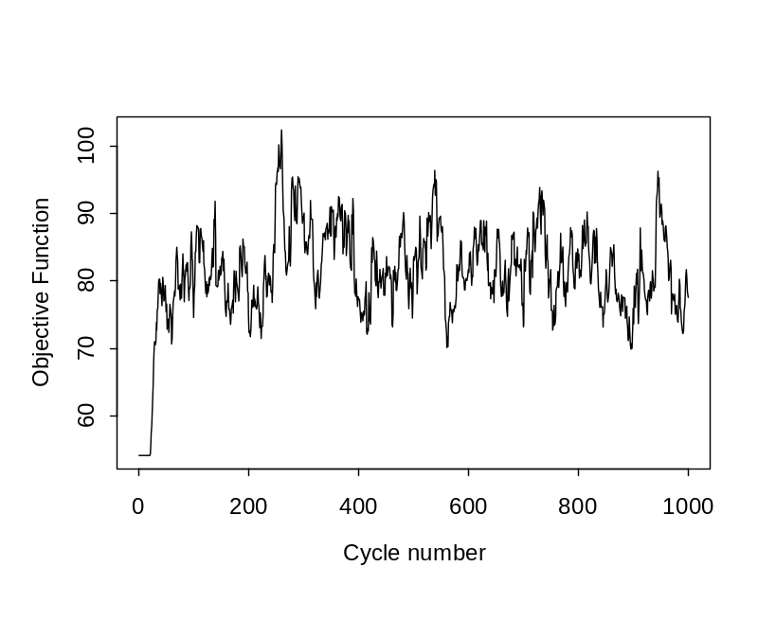
The Geweke Statistic
The Geweke Statistic provides a formal way to interpret the trace.
Compare the mean of the first 10% of the chain with that of the last 50%. Interpret as a z-score.
P<0.001 for the objective
function; culling the first
30% of the chain helps – but
not enough (P is still less
than 0.01)!

Slide 21
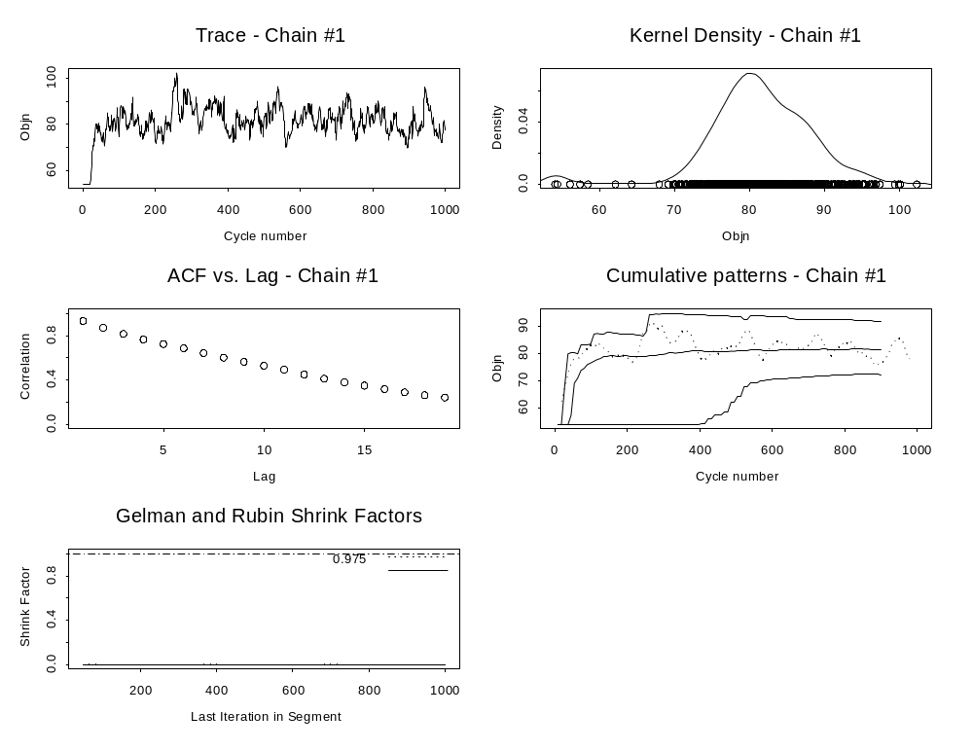
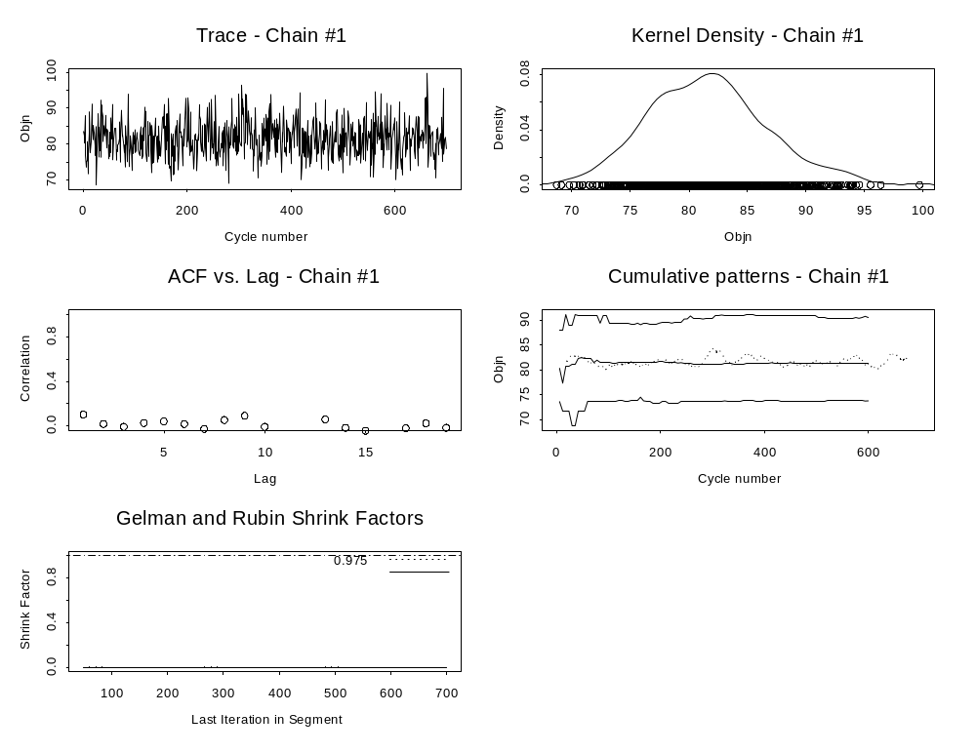
Autocorrelation Statistics-I
Autocorrelation will be high if:
  The jump function doesn’t jump far enough.
  The jump function jumps ‘too far’ – into a region of low density.
Short Chain
Long Chain

Slide 22
Autocorrelation Statistics-II
Compute the standard error of the mean using the standard (naïve) formula, spectral methods, and by “batching” sections of the chain. The latter two approaches implicitly account for autocorrelation. If the SEs from them are much greater than from the naïve method, N needs to be increased.

Slide 23
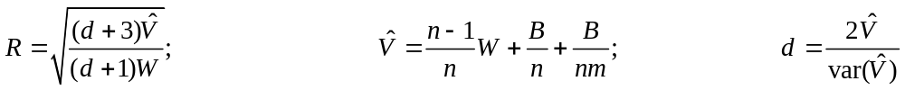
Gelman-Rubin Statistics-I
Conduct multiple (n) MCMC chains (each with different starting values).
Select a set of quantities of interest, exclude the “burn-in” period and thin the chain.
Compute the mean of the empirical variance within each chain, W.
Compute the variance of the mean across the chains, B.
Compute the statistic R:

Slide 24
Gelman-Rubin Statistics-II
This statistic is sometimes simply computed as (B+W)/W.
In general the value of this statistic is close to 1 (1.05 is a conventional “trigger” level) even when other statistics (e.g. the Geweke statistic) suggest a lack of convergence – don’t rely on this statistic alone.
A multivariate version of the statistic exists (Brooks and Gelman, 1997).
The statistic requires that multiple chains are available. However, it can be applied to the results from a single (long) chain by dividing the chain into a number (e.g. 50) of pieces and treating each piece as if it were a different chain.

Slide 25
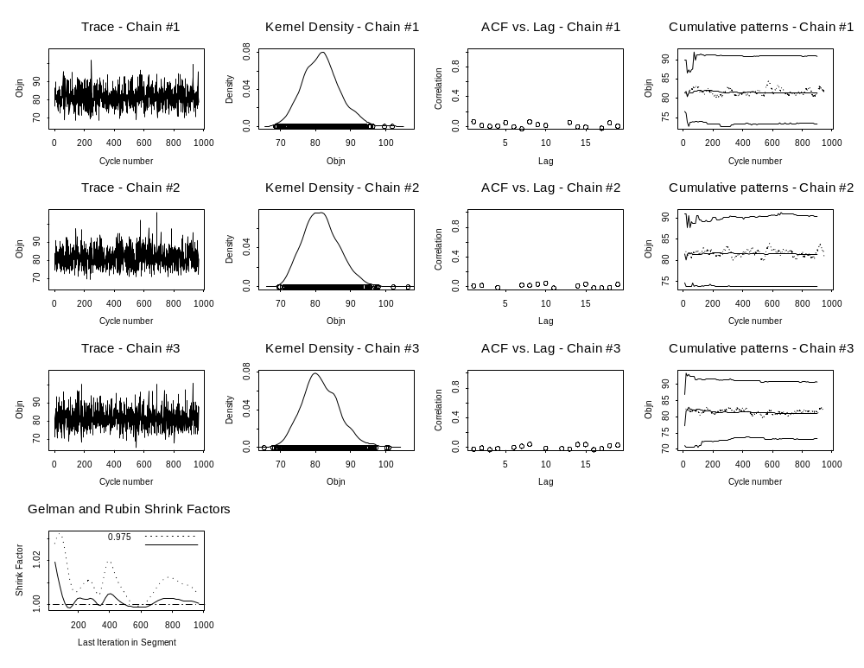
Gelman-Rubin Statistics-III

Slide 26
One Long Run or Many Short Runs?
Many short runs allow a fairly direct check on whether convergence has occurred. However:
  this check depends on starting the algorithm from a “reasonable” set of initial parameter vectors; and
  many short runs involve ignoring a potentially very large fraction of the parameter vectors.
Best to try to conduct many (5-10?) short runs for a least a base-case / reference analysis.

Slide 27
Other Statistics
Heidelberger-Welsh: tests for stationarity of the chain.
Raftery-Lewis: based on how many iterations are necessary to estimate the posterior for a given quantity.

Slide 28
Reporting
Key parameters vs. the kitchen sink
  Detailed reporting important for key outputs.
  Histograms of convergence criteria for less important outputs.
  Correlation plots easily display the relationships among key parameters.

Slide 29
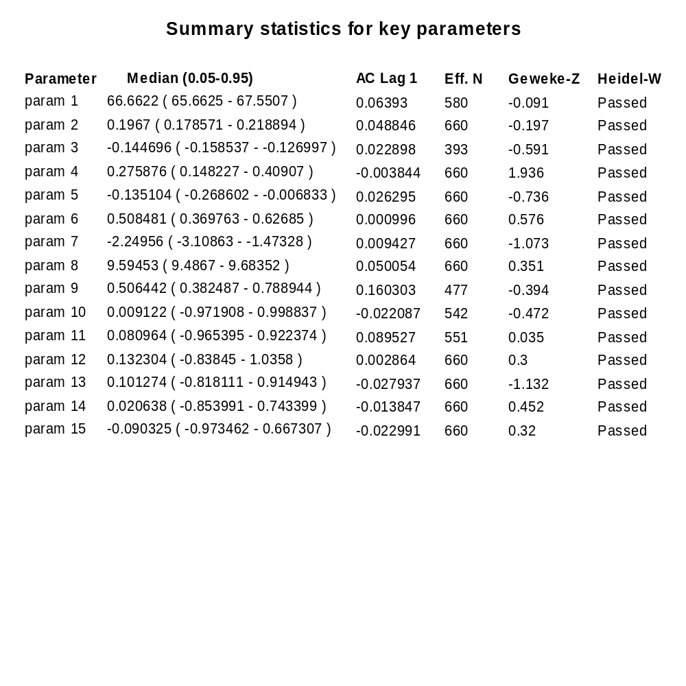
Key Parameters

Slide 30
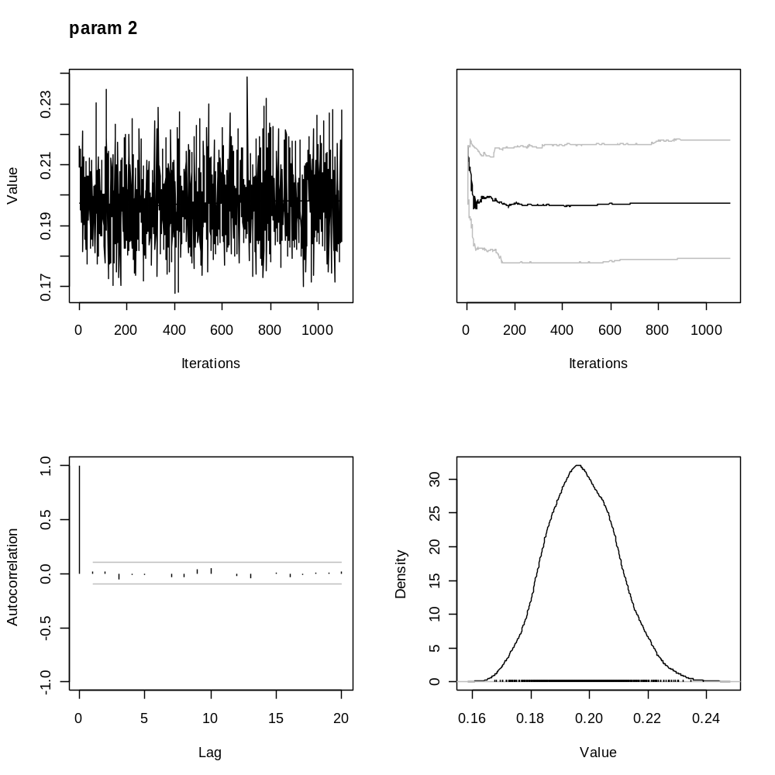

Slide 31
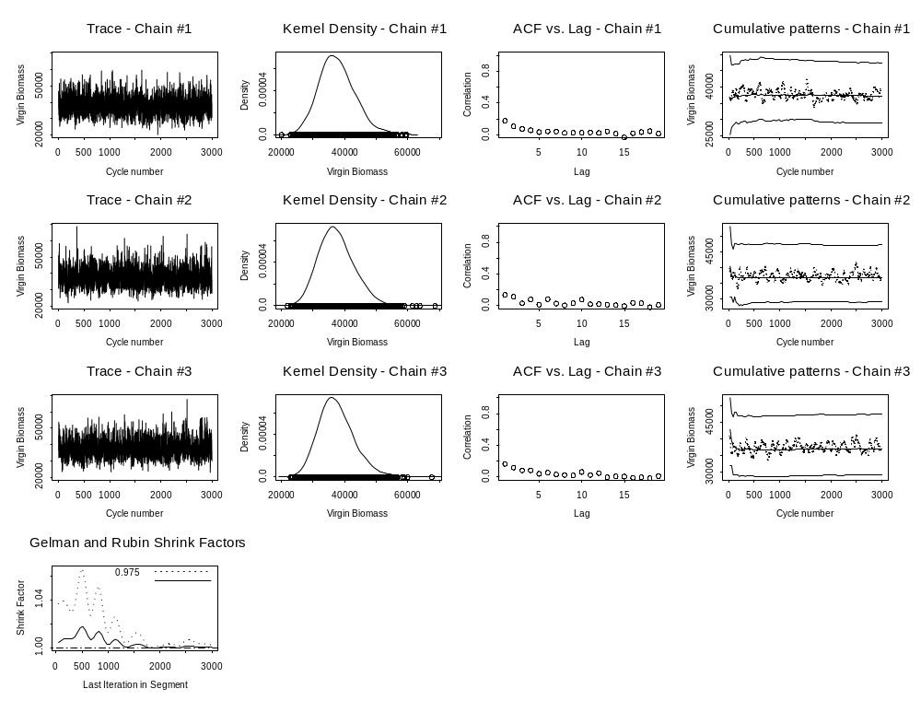
Key parameters: multiple chains

Slide 32
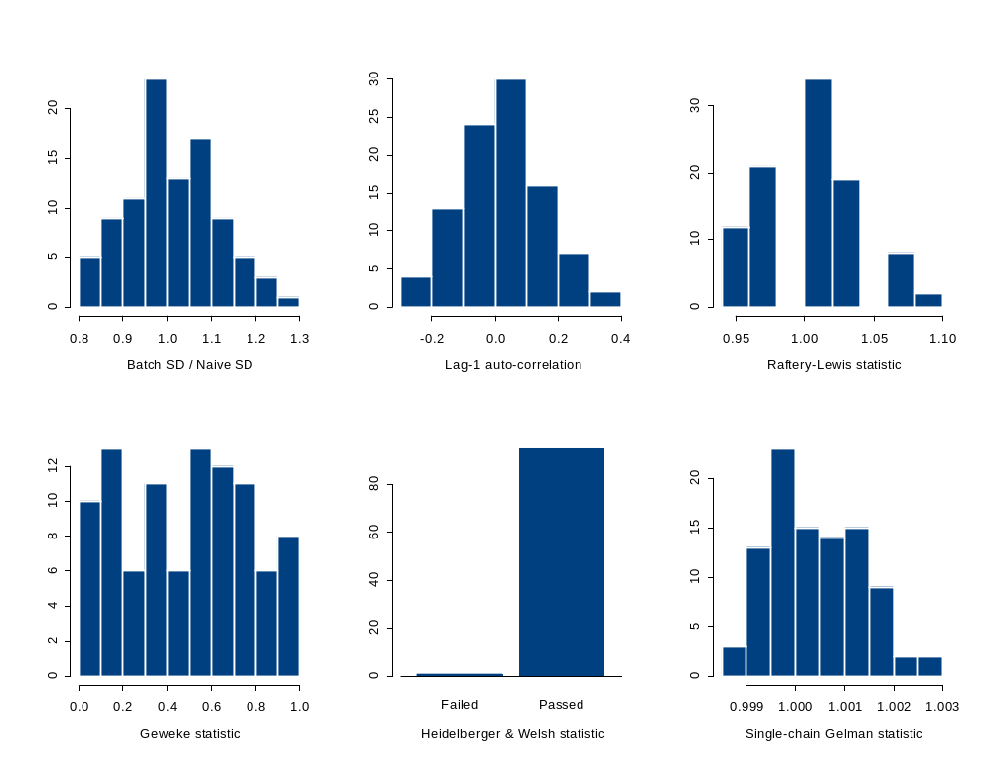
Summary of the diagnostic statistics for the 96 selectivity
parameters in the 2003 assessment of Pacific Ocean Perch

Slide 33
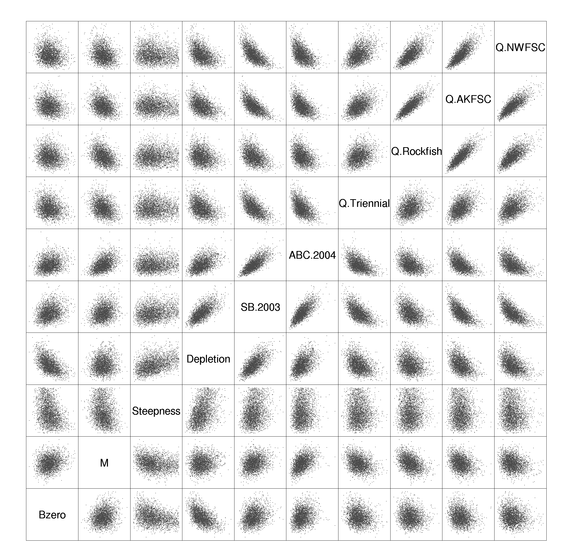

Slide 34
The CODA Package
CODA is a R package that implements all of the diagnostic statistics outlined above. The user can select functions from a menu interface or run the functions directly.
TheData <- read.table("C:\\Courses\\FISH558\\Output.CSV",sep=",")
aa <-mcmc(data=TheData)
codamenu()

Slide 35
Useful References
Brooks, S. and A. Gelman. 1998. General methods for monitoring convergence of iterative simulations. Journal of Computational and Graphical Statistics 7: 434-55.
Gelman, A. and D.B. Rubin. 1992. Inference from iterative simulation using multiple sequences (with discussion). Statistical Science 7: 457-511.
Gelman, A., Carlin, B.P., Stern, H.S. and D.B. Rubin. 1995. Bayesian Data Analysis. Chapman and Hall, London.
Geweke, J. 1992. Evaluating the accuracy of sampling-based approaches to the calculation of posterior moments. pp. 169-93. In: Bayesian Statistics 4 (eds J.M. Bernardo, J. Berger, A.P. Dawid and A.F.M. Smith.) Oxford University Press, Oxford.

